Slide 1





IOT SOLUTIONS
Smart Classroom Project
Course Details
Course: Embedded IoT Systems
Instructor: Sir Nasir Mehmod
Date: 22/12/2025
IoT-Based Student Monitoring & Evaluation System
University
National Textile University
Faisalabad
Mahnoor Shahid
Department of Computer Science
Sarwat Fatima
BSCS 5th-A | Reg: 23-NTU-CS-1042, 23-NTU-CS-1092

Slide 2
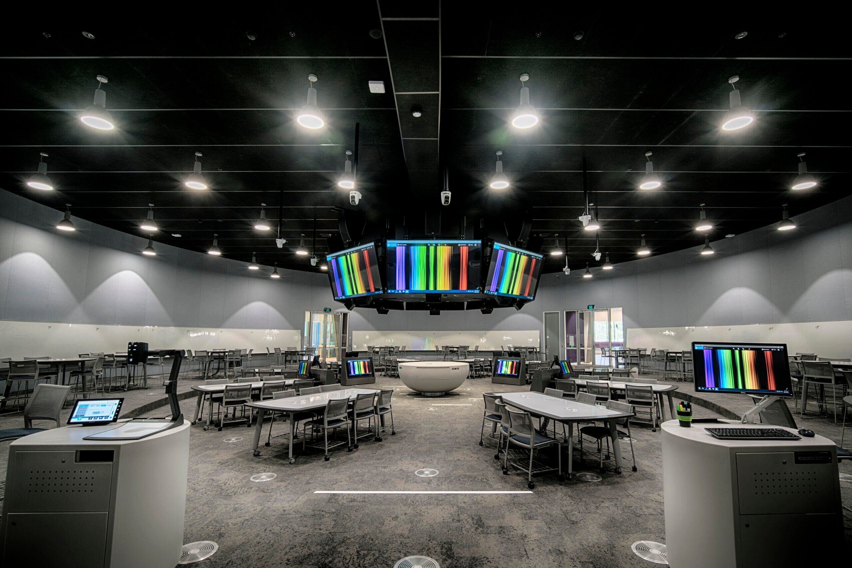




Project Overview
IoT-based monitoring system enabling real-time tracking of student activity and performance evaluation in classroom environments.
Real-time Tracking
Student presence & presentation engagement
Performance Feedback
Automated evaluation & scoring system
Classroom Dynamics
Comprehensive monitoring & analysis
Efficient Evaluation
Interactive Learning Environment
Teacher-friendly activity recording

Slide 3










System Architecture
CORE
PIR Sensor
ESP32
LDR Sensor
Motion Detection
Microcontroller
Light Detection
Pin 34
Wi-Fi + Bluetooth
Pin 35
Dual Core
Blynk Platform
Web Server
Mobile Dashboard
Custom Dashboard
Node-RED
Database
Database Middleware
Permanent Storage
Data Flow: Sensors → ESP32 → Blynk/Web → Node-RED → Database

Slide 4
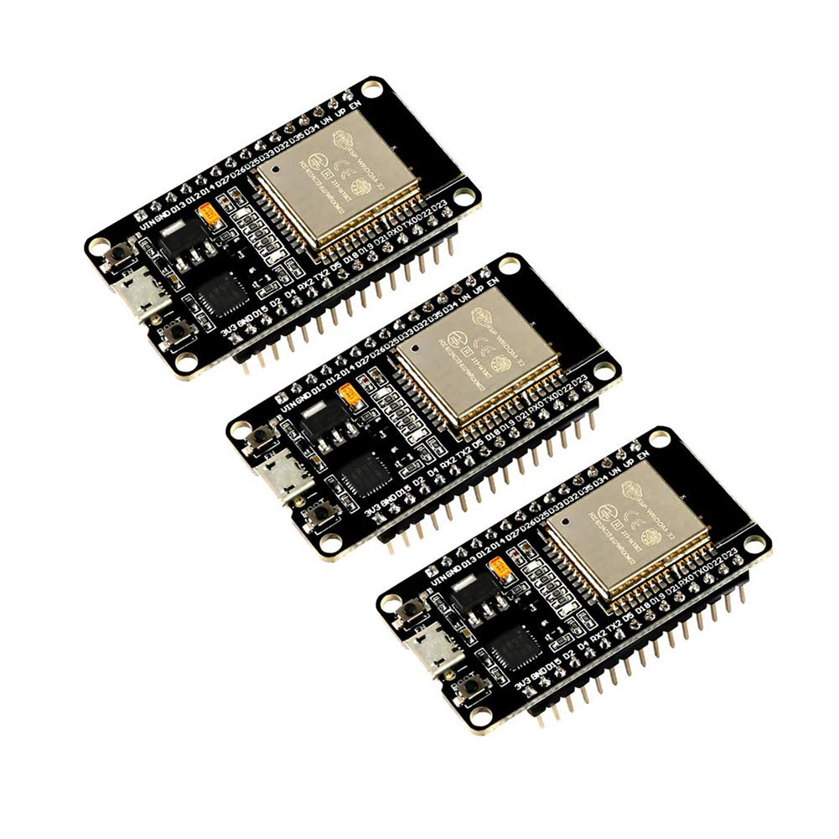





Hardware Components
ESP32
Microcontroller
Low-cost, energy-efficient
Wi-Fi + Bluetooth connectivity
Dual-core processor
Multiple peripherals
Fine-grained power modes
Peripherals: Touch, CAN, SDIO, I2S
ESP32 Development Board

Slide 5









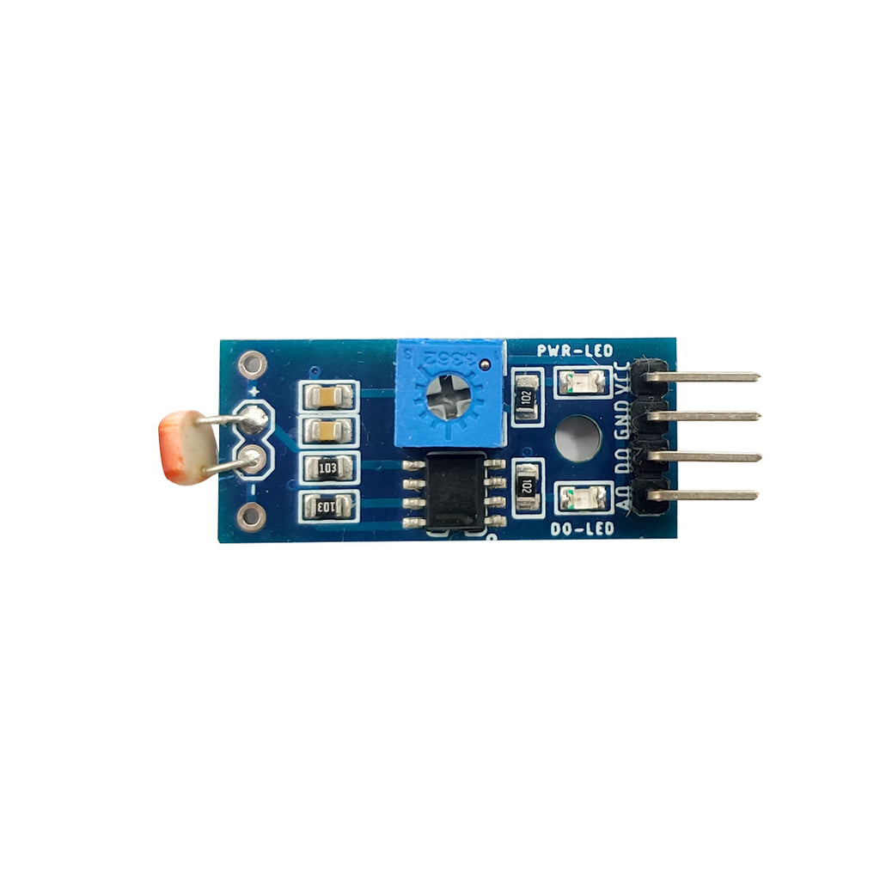
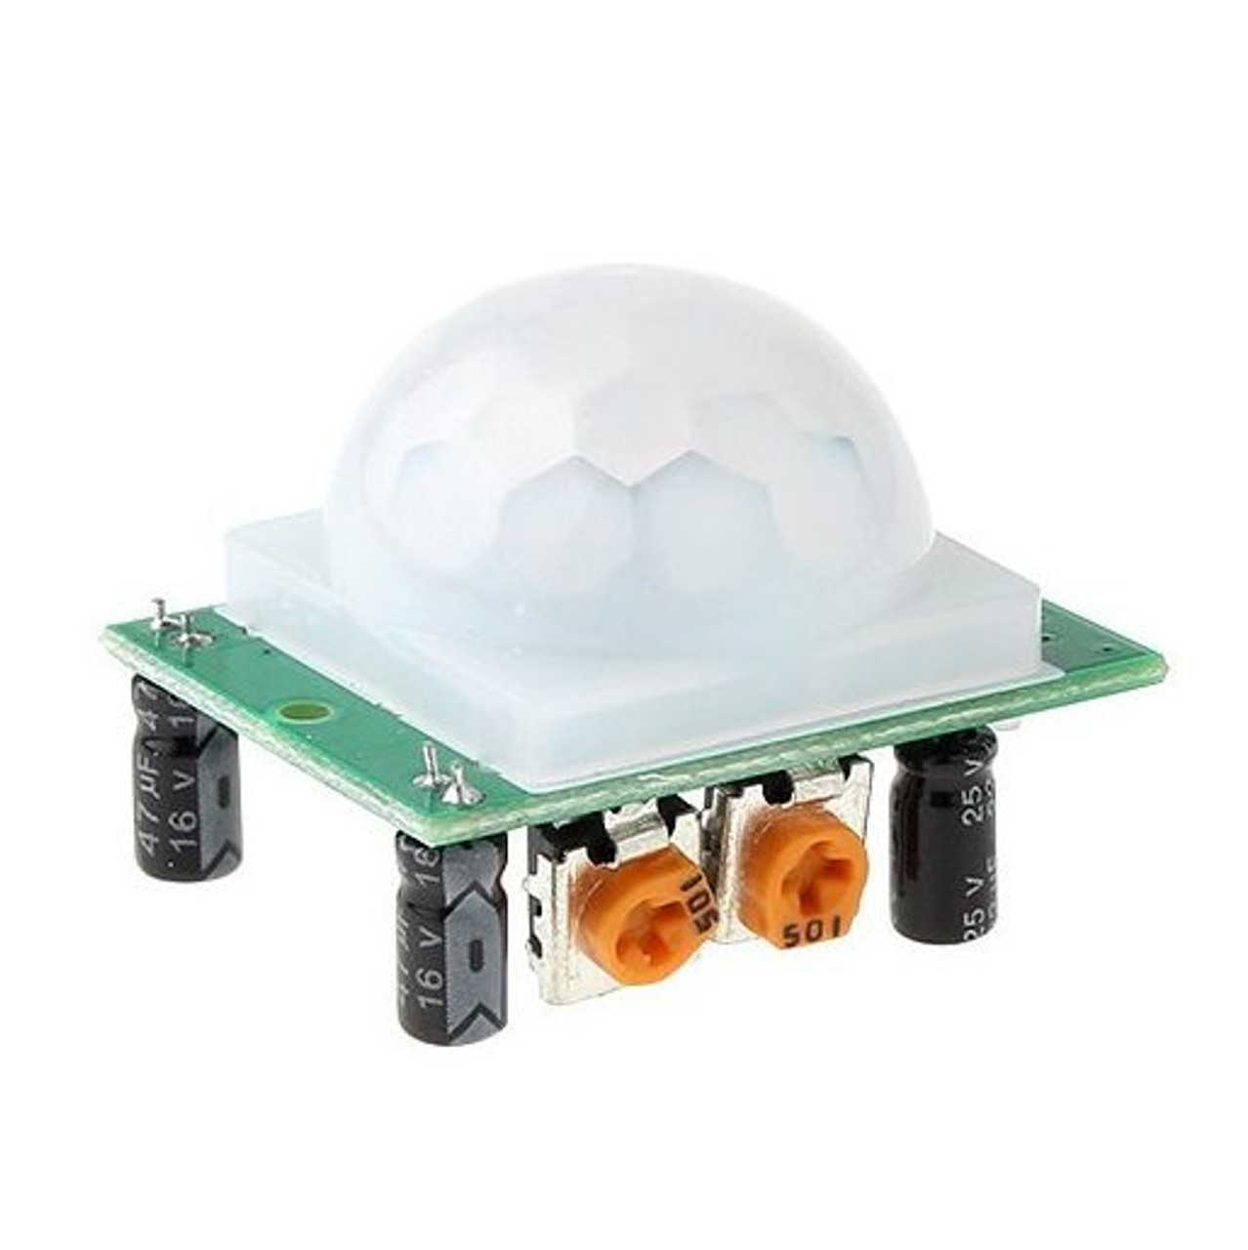
Hardware Components - Sensors
PIR Sensor
LDR Sensor
Passive Infrared Motion Detector
Light Dependent Resistor
Detects motion via infrared radiation
Works on photoconductivity principle
Monitors student presence/activity
Detects projector status (ON/OFF)
Connected to Pin 34
Connected to Pin 35
Detection range: 3-7 meters
Measures light intensity changes
100-degree angle

Slide 6
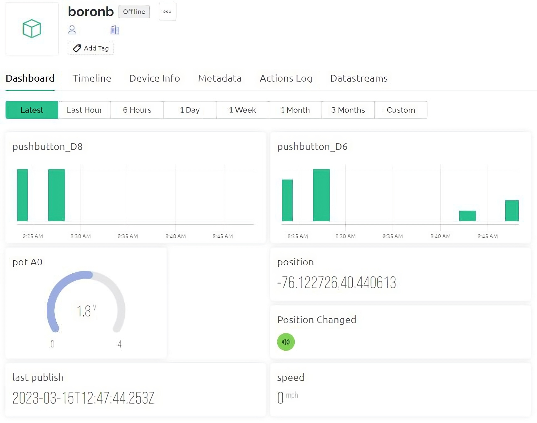






Blynk IoT Platform
Key Features
Low-code platform
Real-time visualization
Mobile app dashboard
Virtual pin exchange
Drag-and-drop interface
Cloud connectivity
Virtual Pins Configuration
V2
V3
V5
Student Select
Active Student
PIR Data
V6
V10
V12
Projector Status
Presentation Time
Attendance
V15
V16
V17-19
Score
Remarks
Save Operations
Blynk Mobile Dashboard

Slide 7




Key Features
Student Activity Monitoring
Blynk Integration
Mobile app interface
Presence detection via PIR sensor
Live data visualization
Presentation tracking via LDR sensor
Remote control capabilities
Real-time activity updates
Feedback & Analytics
Web Dashboard
Automated engagement scoring
Custom web interface
Dynamic feedback generation
Real-time statistics
Performance metrics
Chart.js visualizations & student table

Slide 8






Engagement Calculation
Scoring Algorithm
Feedback Generation Logic
Base Score Formula
Attendance Feedback
Base Score = (Attendance × 40%) + (Presentation × 60%)
≥15%
Excellent class participation!
10-15%
Good engagement, try to participate more
<10%
Needs to increase participation
Bonus Points
Presentation Feedback
+10 if remarks mention "participation"
≥15%
Outstanding presentation skills
Penalty
10-15%
Solid presentation delivery
-15 if attendance < 50%
<10%
Practice presentation timing
Final Score Range: 0-100%

Slide 9

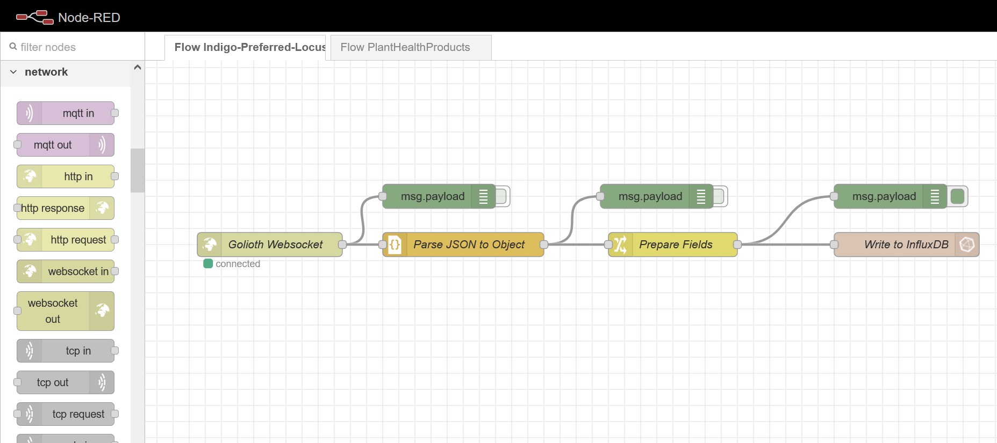






Node-RED Database Integration
Purpose
Permanent data storage for student records
Architecture Flow
ESP32
MQTT
Node-RED
Database
MQTT Config
Data Format
Port:
1883
JSON structure
Broker:
10.226.199.65
student, attendance, presentation, score, remarks
Topic:
smartclassroom/student
Key Advantages
Permanent storage
Historical tracking
Node-RED Flow Diagram
Auto reports
Multi-user access
MQTT → JSON Parse → Database
Analytics & visualization

Slide 10












Web Dashboard Features
Student Overview Table
Dashboard Preview
Displays attendance, presentation, scores, remarks
Engagement Scores
Color-coded cells for quick status identification
Auto-generated feedback per student
Teacher Notes
Visual Analytics
Haruki
Mano
Ibana
Amna
Top engaged students
Chart.js bar charts
Student Data
Feedback
Lowest engaged students
Real-time data updates
Attendance:
85%
Excellent class participation! Outstanding presentation skills.
Present.
92%
Score:
88
Access Information
http://<ESP32-IP>
Accessible on local network via browser

Slide 11







System Workflow
1
2
3
Setup Phase
Main Loop
Data Collection
Initialize pins
Handle Blynk UI requests
Read PIR sensor (presence)
Blynk & WiFi connection
Process sensor timer events
Read LDR sensor (projector)
Setup timers & web server
Manage web server
Calculate engagement scores
4
5
Data Transmission
Feedback Generation
Push to Blynk mobile app
Generate automated feedback
Update web dashboard
Save to database permanently
Send to Node-RED via MQTT
Continuous Monitoring Cycle

Slide 12





Conclusion
Project Achievements
Future Enhancements
Interactive sensor-driven evaluation system
Integration with more sensors
Combines mobile and web dashboards
Advanced analytics and AI predictions
Real-time monitoring capabilities
Cloud-based storage and access
Automated feedback generation
Mobile app improvements
Database integration for historical tracking
Multi-classroom support
Thank You!
Mahnoor Shahid
Questions & Discussion
23-NTU-CS-1042

